Slide 1
Tutorial week 11
Answered by Anis Faqihah Binti Kamarulzaman (CS2305C)

Slide 2
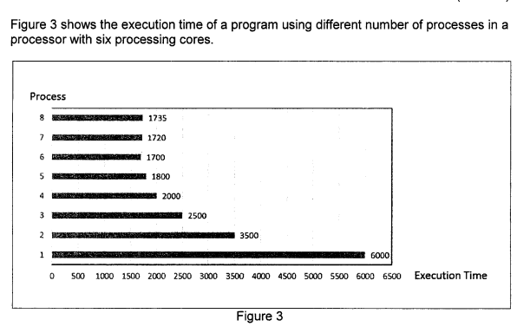
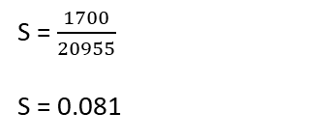
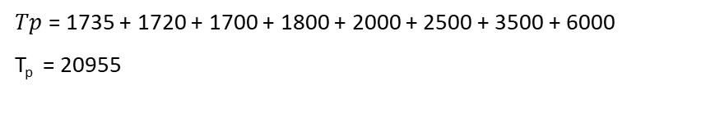
Q1
Refer to Slide Lecture 8,
1. Calculate the speedup for every execution.
$Ts$ =1700
$Tp$ = 1735 + 1720 + 1700 + 1800 + 2000 + 2500 + 3500 + 6000
T_{p} = 20955
S = $\frac{1700}{20955}$
S = 0.081

Slide 3
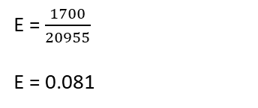
Q1
2. Calculate the efficiency for every execution.
E = $\frac{1700}{20955}$
E = 0.081
3. Assume there are more than six processes, discuss a reason behind the decline of speedup.
The increasing in number of processes will cause the increasing in parallel overhead due to inter-process interaction, idling time, and excess communication.
The inter-process interaction is the time needed for communicating the data within multiple processing elements.
The idling time is the time needed for processing elements when they are not doing anything/when they are waiting for the other instruction.
Excess computation may occur due to multiple execution on different processing elements to obtain the same results.

Slide 4
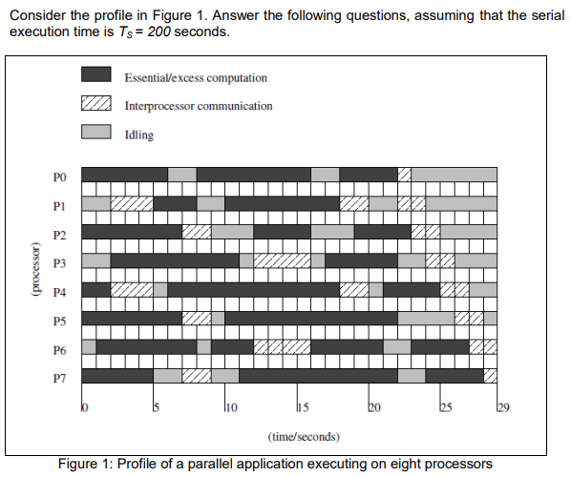

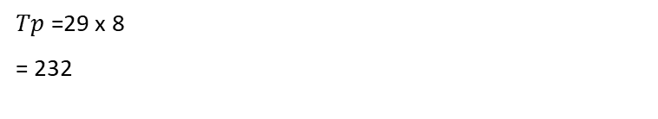

Q2
Refer to Slide Lecture 8,
1. Calculate the parallel execution time (Tp) of the execution.
$Tp$ = $Tcomputation+Tcommunication+Tidle$
$Tp$ = $\frac{1}{P}$ $\left(Tcomputation+Tcommunication+Tidle\right)$
$Tp$ =29 x 8
= 232
https://www.mcs.anl.gov/~itf/dbpp/text/node29.html
2. Calculate the speedup (Sp) of the execution.
S = $\frac{200}{232}$
S = 0.862

Slide 5
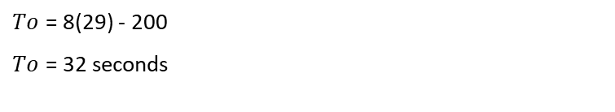
3. Calculate the total parallel overhead (To) of the execution.
$To$ = 8(29) - 200
$To$ = 32 seconds

Slide 6
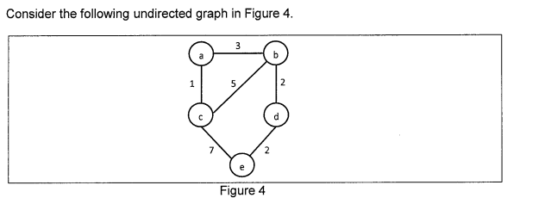
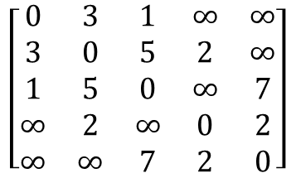
Q3
1. List the steps and results for drawing MST using the parallel Kruskal algorithm.
Step 1: Find the cheapest edge in the graph (if there is more than one, pick one at random). Mark the visited edge.
Step 2: Find the cheapest unvisited edge in the graph.
Step 3: Repeat Step 2 until you reach out to every vertex of the graph (or you have N ; where N is the number of Vertices.) The visited edges form the desired minimum spanning tree.
Cost of Kruskal MST = 1 + 2 + 2 + 3 = 8
Visited {(a,c),(b,d),(a,b),(d,e)}
Visited {(a,c),(b,d)}
$$\left[\begin{matrix}0 & 3 & 1 & ∞ & ∞ \\ 3 & 0 & 5 & 2 & ∞ \\ 1 & 5 & 0 & ∞ & 7 \\ ∞ & 2 & ∞ & 0 & 2 \\ ∞ & ∞ & 7 & 2 & 0\end{matrix}\right]$$
a
b
3
a
b
1
2
1
2
c
d
c
d
2
e

Slide 7
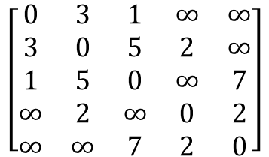




Q3
2. Assume you have several processors. Compare the stages/ processes needed to build the MST using parallel Prim’s and parallel Kruskal algorithms.
Prim's algorithm
Step 1: Select an arbitrary vertex, include it into the current MST.
Step 2: Grow the current MST by inserting into it the vertex closest to one of the vertices already in current MST.
Cost of Prism MST = 1 + 3 + 2 + 2 = 8
$$\left[\begin{matrix}0 & 3 & 1 & ∞ & ∞ \\ 3 & 0 & 5 & 2 & ∞ \\ 1 & 5 & 0 & ∞ & 7 \\ ∞ & 2 & ∞ & 0 & 2 \\ ∞ & ∞ & 7 & 2 & 0\end{matrix}\right]$$
1 | 5 | 0 | $$∞$$ | 7
3
3
a
b
a
b
1 | 3 | 0 | $$∞$$ | 7
1
2
1
1 | 3 | 0 | $$2$$ | 7
c
c
d
1 | 3 | 0 | $$2$$ | 2
e
2

